Slide 1
CAREER INFORMATION AND RECRUITMENT PORTAL
Project Guide: Ms. Sruthimol M P
Lecturer
Department of Information Technology
Group Members:
Jincy P Janardhanan (IEAREIT017)
Aleena Sunny (IEAREIT006)
Alka Bhagavaldas K (IEAREIT007)
Ameena Shirin (IEAREIT009)

Slide 2
CONTENTS
Problem Statement
Motivation
Objectives
System Study
Requirements Gathering and Analysis
SRS Document
Design
References

Slide 3
PROBLEM STATEMENT
Students can’t find the right job.
Recruiters can’t access student details.
Important functions may be missed.
Students miss recruiter updates.
No effective placement cell management.

Slide 4
MOTIVATION
Provide a user-friendly recruitment portal platform.
Ease the work of staffs.
Provide medium to choose best companies and employees.
Provide categorized and suitable jobs.
Increase knowledge about job resources.

Slide 5
OBJECTIVES
Developing a web application for career information and recruitment.
Connect students, colleges, recruiters and alumni.
Ease of job application.
Easily maintain job information and applications.
Easily review CV of student or alumni.
Recruiters can easily maintain job details.

Slide 6
SYSTEM STUDY
EXISTING SYSTEM
PROPOSED METHODOLOGY
Manually maintained
Time consuming
Difficult to updating data
Errors can occur
Data storing is difficult
A secure and easy-to-use web application in Java using Spring boot and Spring security frameworks
Placement cell management for colleges
Student or alumni hiring for recruiters
Job finding opportunity for student and alumni
FEASIBILITY STUDY
Feasible on a system with basic requirements
Technical feasibility: easy to use
Easy to maintain the operation
Schedule and maintenance is easier
Low budget

Slide 7
REQUIREMENTS GATHERING AND ANALYSIS
END-USER REQUIREMENTS
HARDWARE REQUIREMENTS
SOFTWARE REQUIREMENTS
PC with basic requirements
Stable network connection
4 GHz minimum, multi-core processor
RAM: Minimum 2 GB
Hard disk space: Minimum 10 GB
Operating System:
Windows 7+
Mac OS X Yosemite 10.10+
Linux: 64-bit Ubuntu 14.04+, Debian 8+, openSUSE 13.3+ or Fedora Linux 24+
Front end: Thymeleaf
Back end: Spring boot, Spring security and MongoDB
Web server: Embedded Tomcat
Supported browsers: Chrome, Firefox, Internet Explorer 9+
Java 1.8+

Slide 8
SRS DOCUMENT
Software Requirements Specification (SRS), documents all expected functionalities of a system/application by the end user.
Our SRS Document for this project can be found from here.

Slide 9
DESIGN

Slide 10
DATA FLOW DIAGRAMS

Slide 11
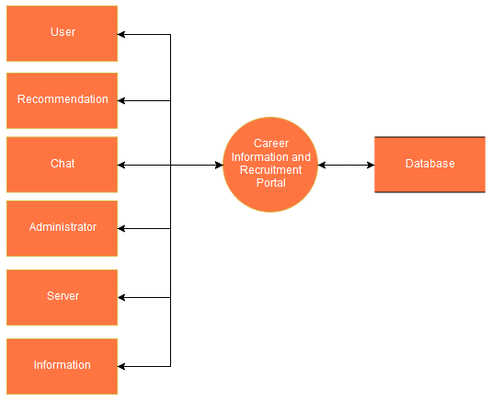
LEVEL 0
Level 0. Context Diagram for Career Information and Recruitment portal.

Slide 12
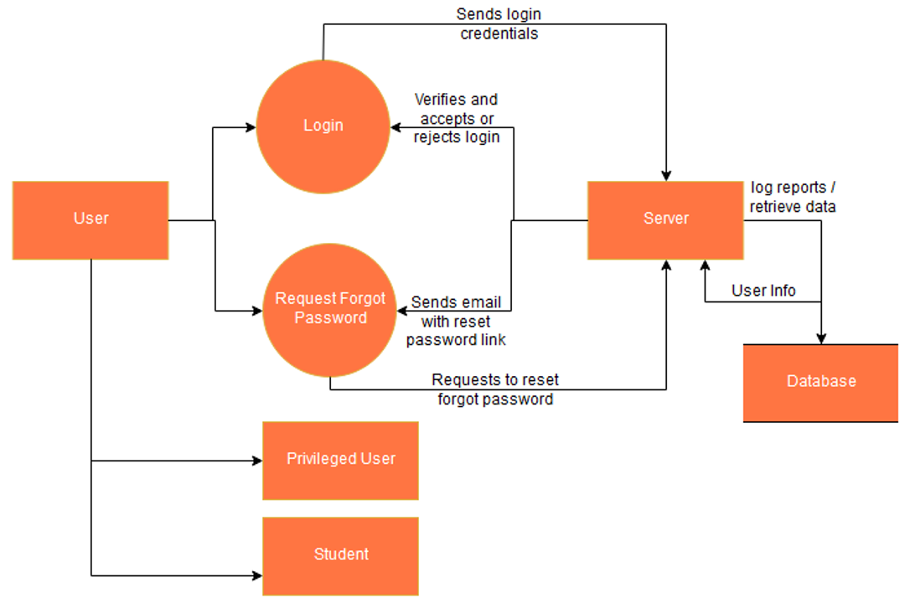
LEVEL 1 DIAGRAMS
Level 1.1 User module - implemented as class

Slide 13
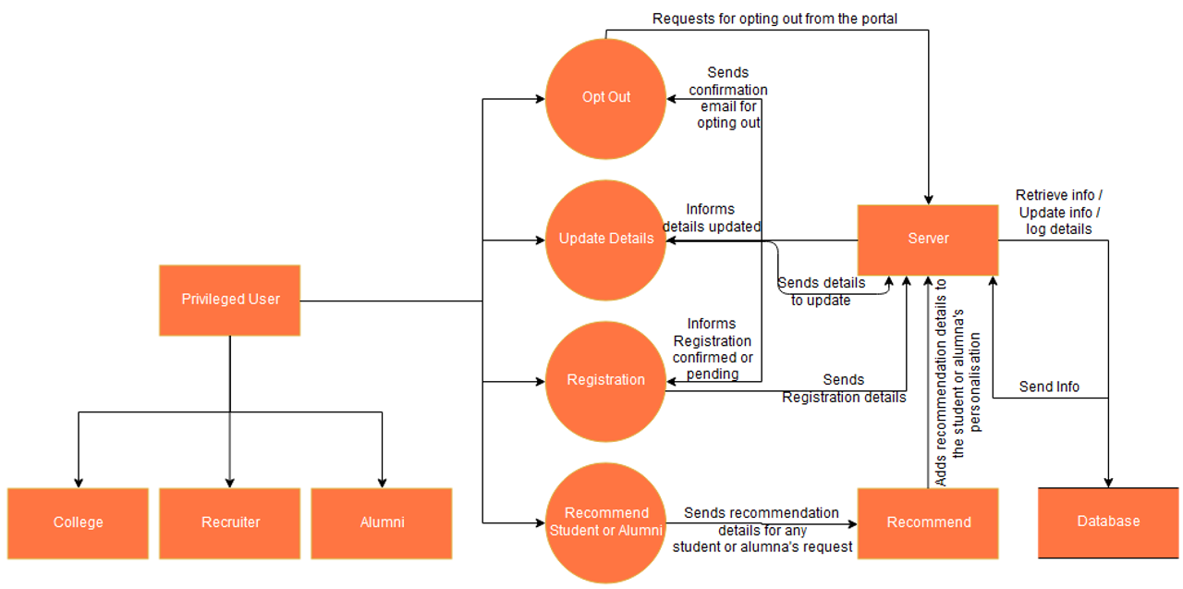
Level 1.1.1 - Privileged User (sub-module of User (1.1), implemented via interfaces only)

Slide 14
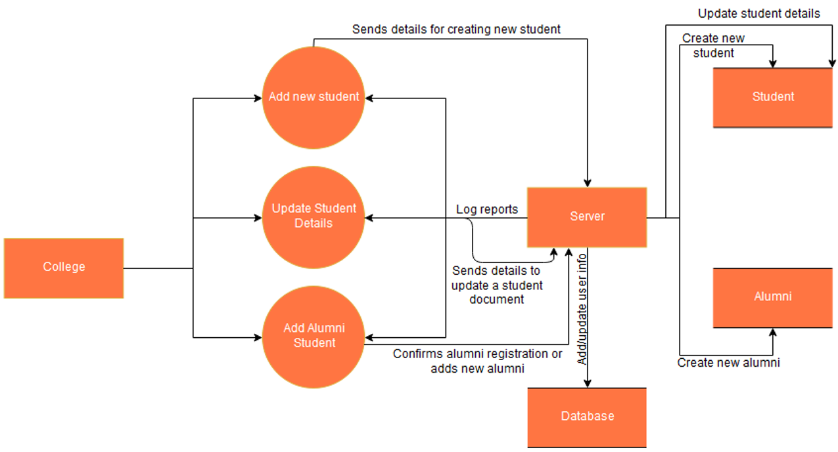
Level 1.1.1.1 - College module (implements Privileged User interface, implemented as class)

Slide 15
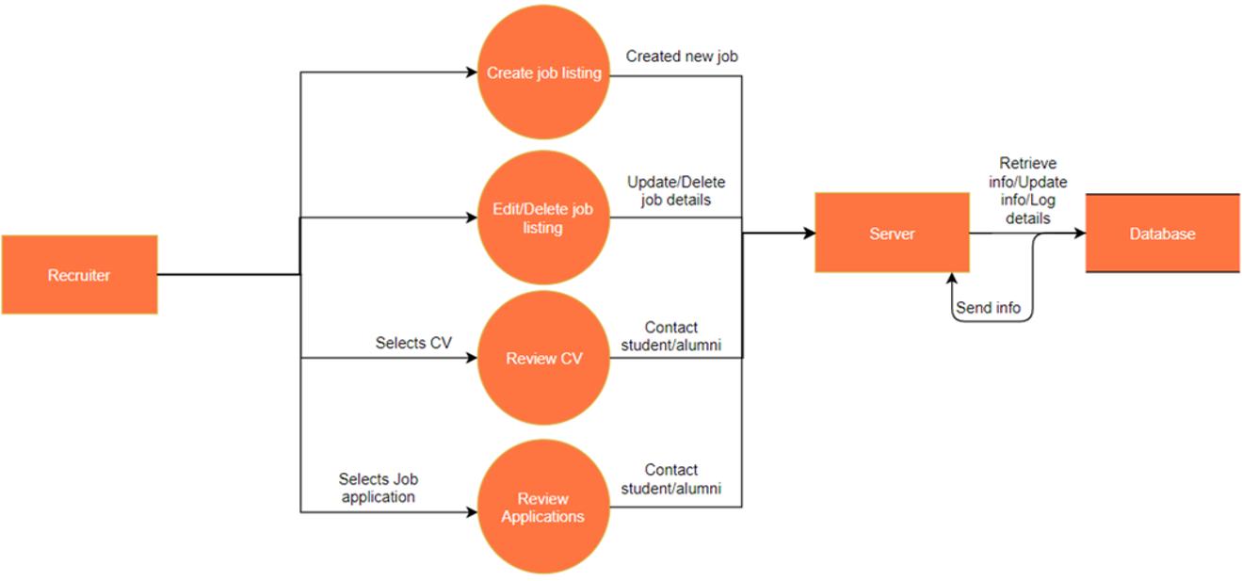
Level 1.1.1.2 - Recruiter module (implements Privileged User interface, implemented as class)

Slide 16
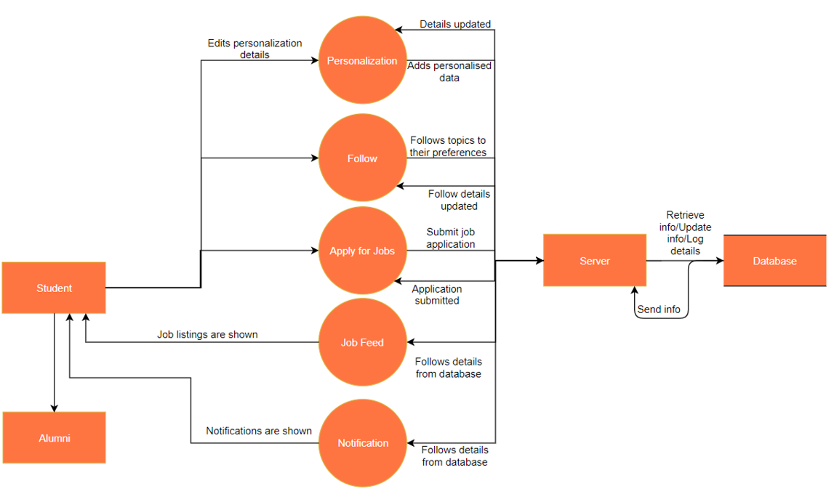
Level 1.1.2 - Student (Sub-module of User (1.1), implemented as class)

Slide 17
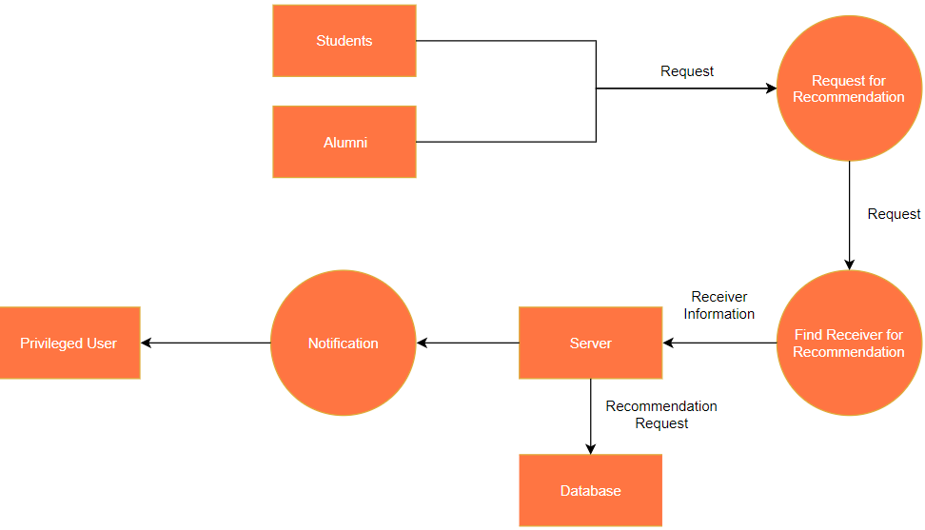
Level 1.2.1 - Request Recommendation (Recommendation module (1.2) has two functions - Request Recommendation and Recommend, both are implemented via separate interfaces and hence considered as sub-modules.)

Slide 18
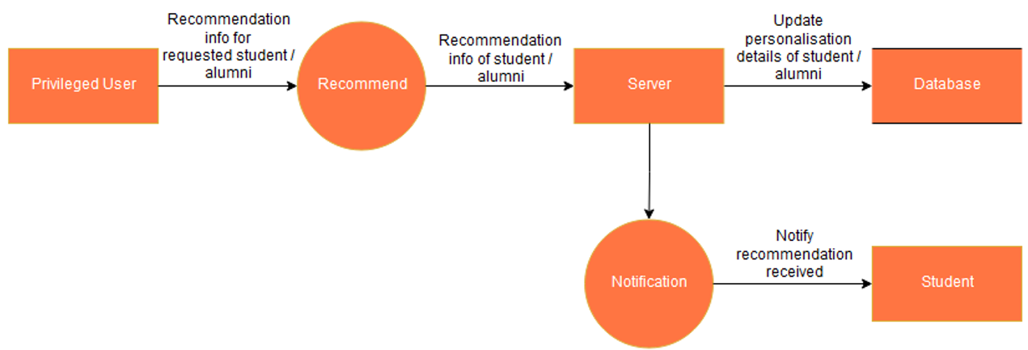
Level 1.2.2 - Recommend (Recommendation module (1.2) has two functions - Request Recommendation and Recommend, both are implemented via separate interfaces and hence considered as sub-modules.)

Slide 19
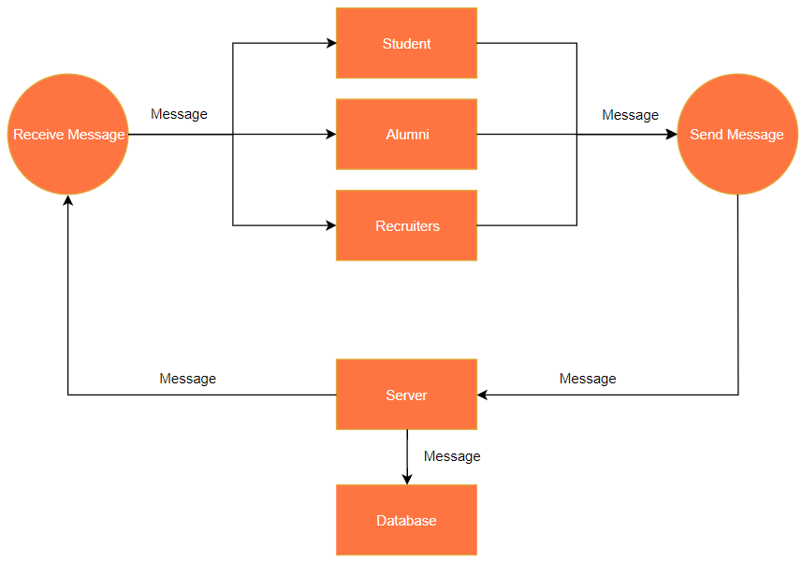
Level 1.3 - Chat (Implemented via interfaces only, implemented by Recruiter and Student classes)

Slide 20
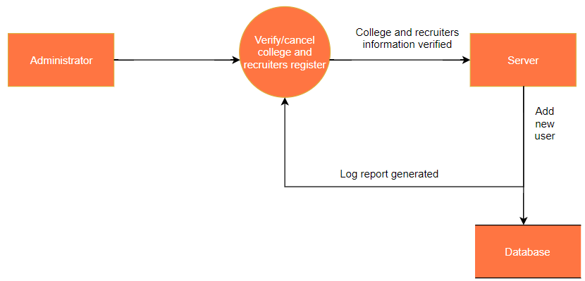
Level 1.4 - Administrator module (Implemented as class)

Slide 21
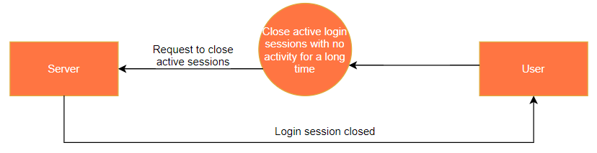
Level 1.5 - Server module (Implemented as class)

Slide 22
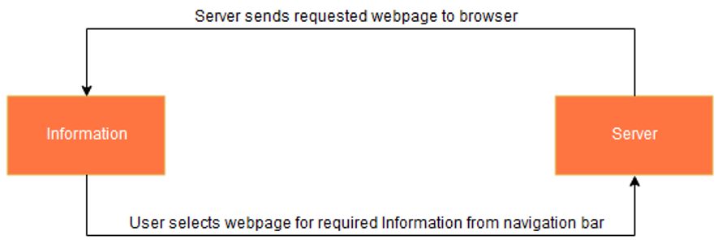
Level 1.6 - Information module (module used to display web pages for career information)

Slide 23
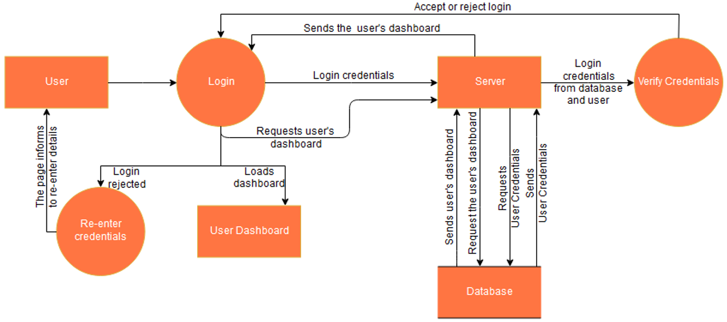
LEVEL 2 DIAGRAMS
Level 2.1 - User login

Slide 24
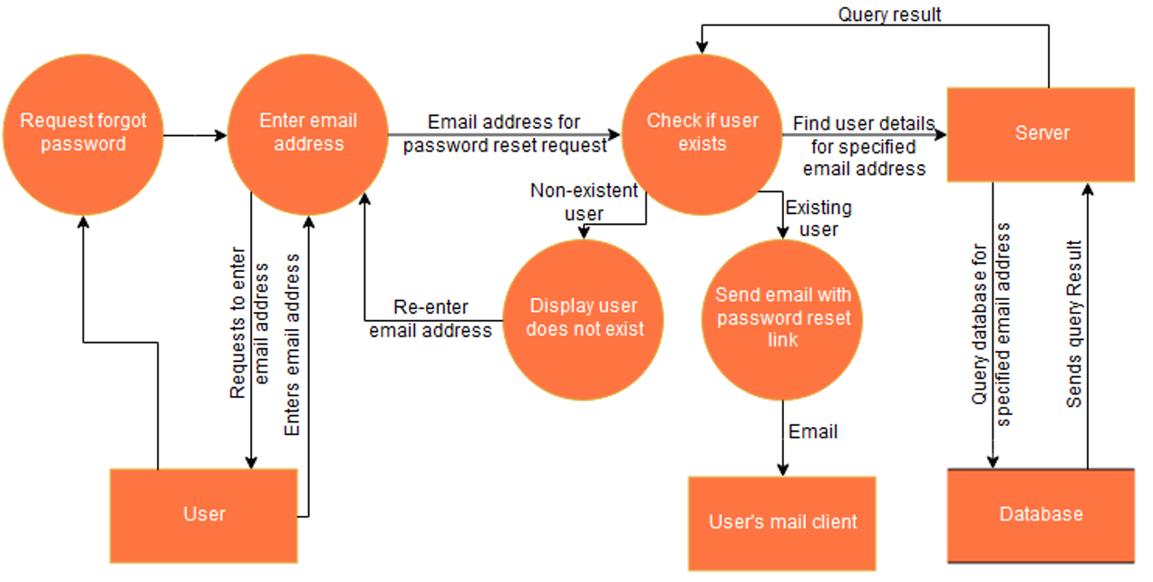
Level 2.2 - Request for forgot password

Slide 25
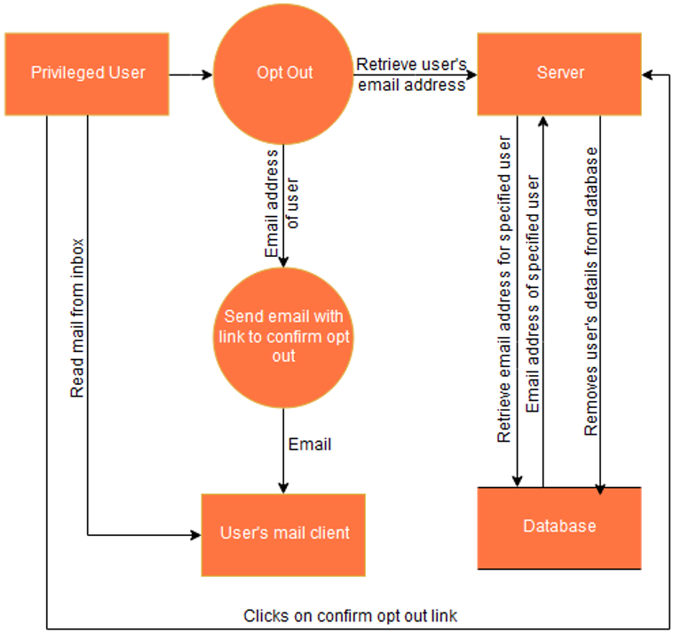
Level 2.3 - Opt out request by any privileged user

Slide 26
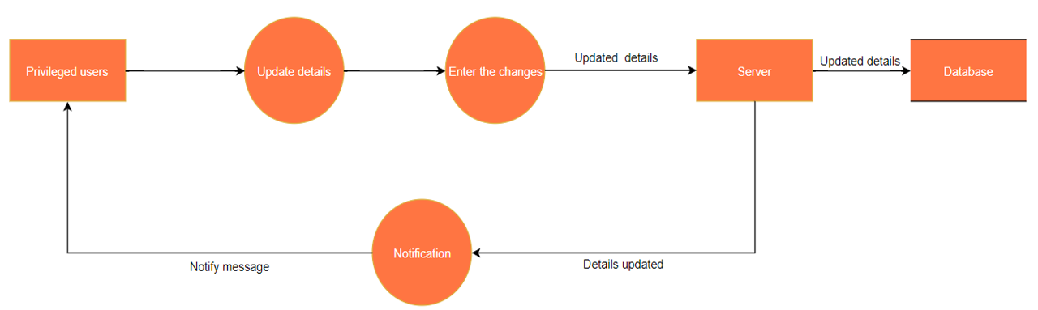
Level 2.4 - Update details of any privileged user

Slide 27
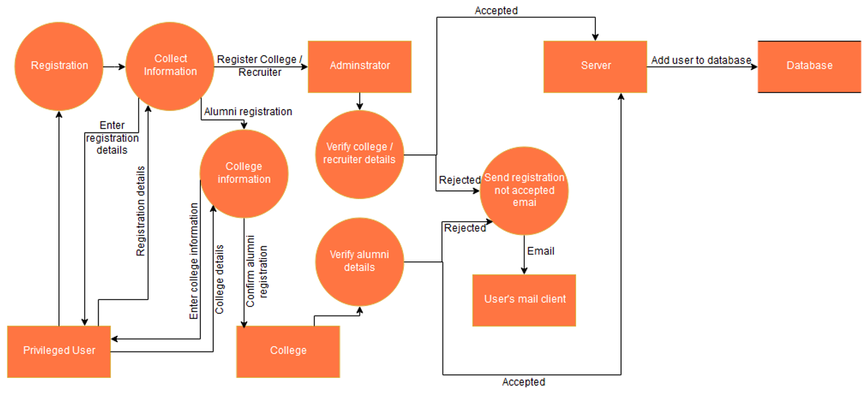
Level 2.5 - Registration of any privileged user

Slide 28
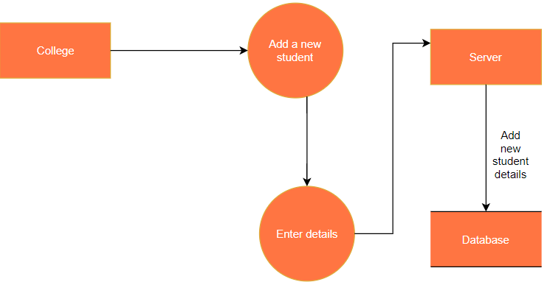
Level 2.6 - Add new student by college

Slide 29
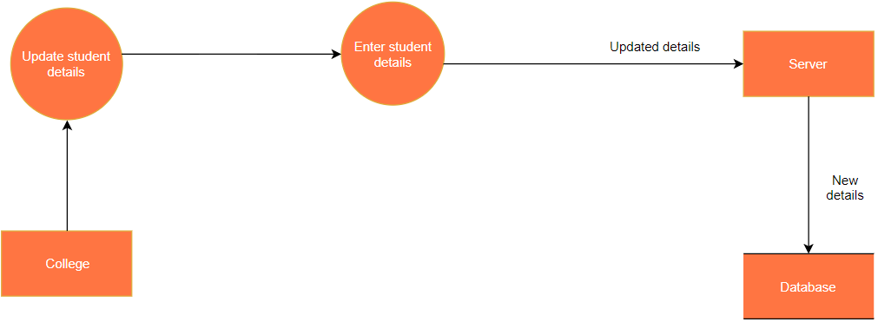
Level 2.7 - Update student details by college

Slide 30
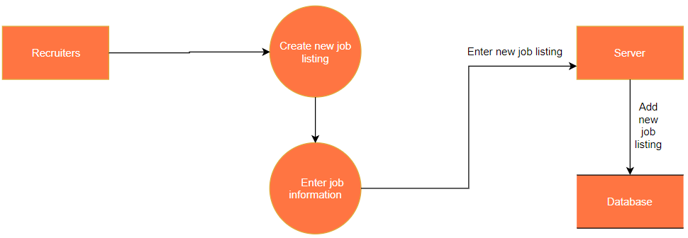
Level 2.8 - Create new job listing by Recruiter

Slide 31
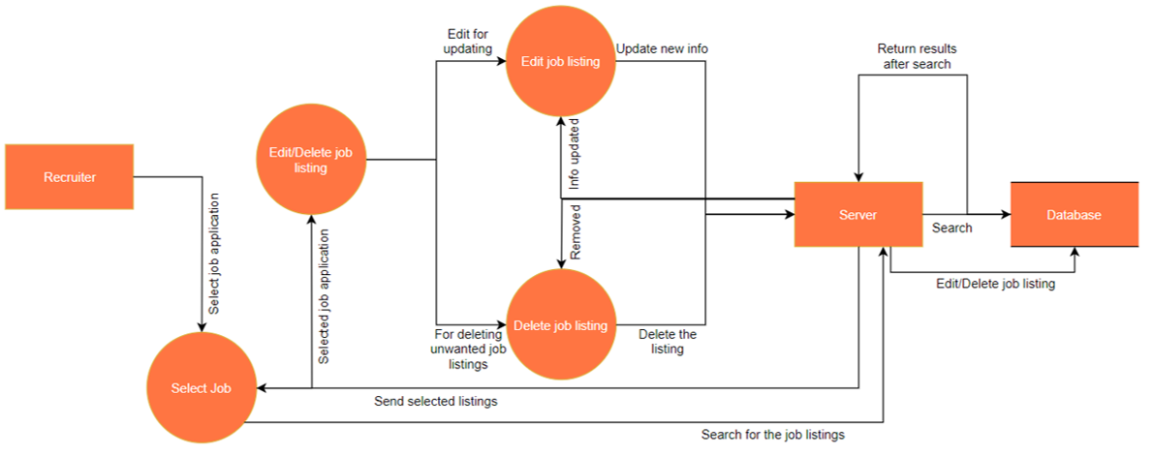
Level 2.9 - Edit or delete job listing by recruiter

Slide 32
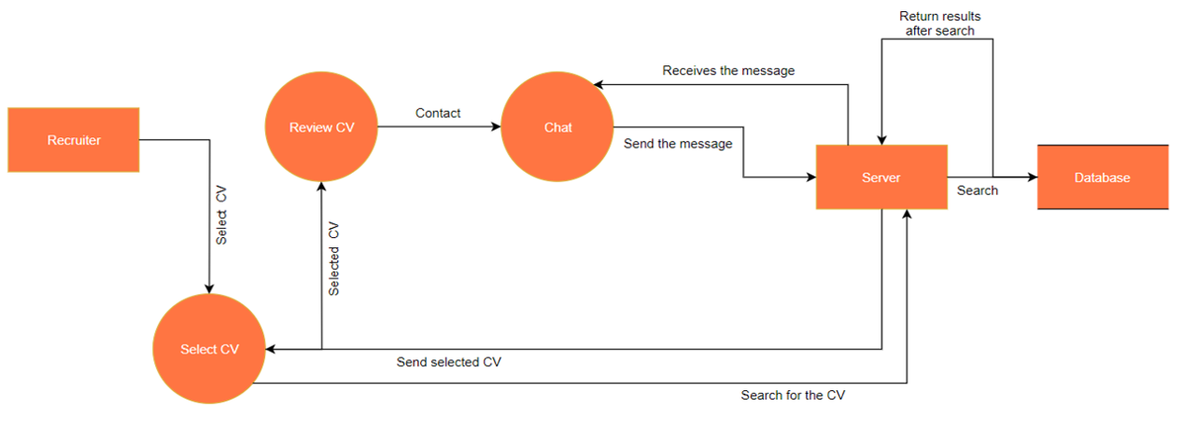
Level 2.10 - Review CV by Recruiter

Slide 33
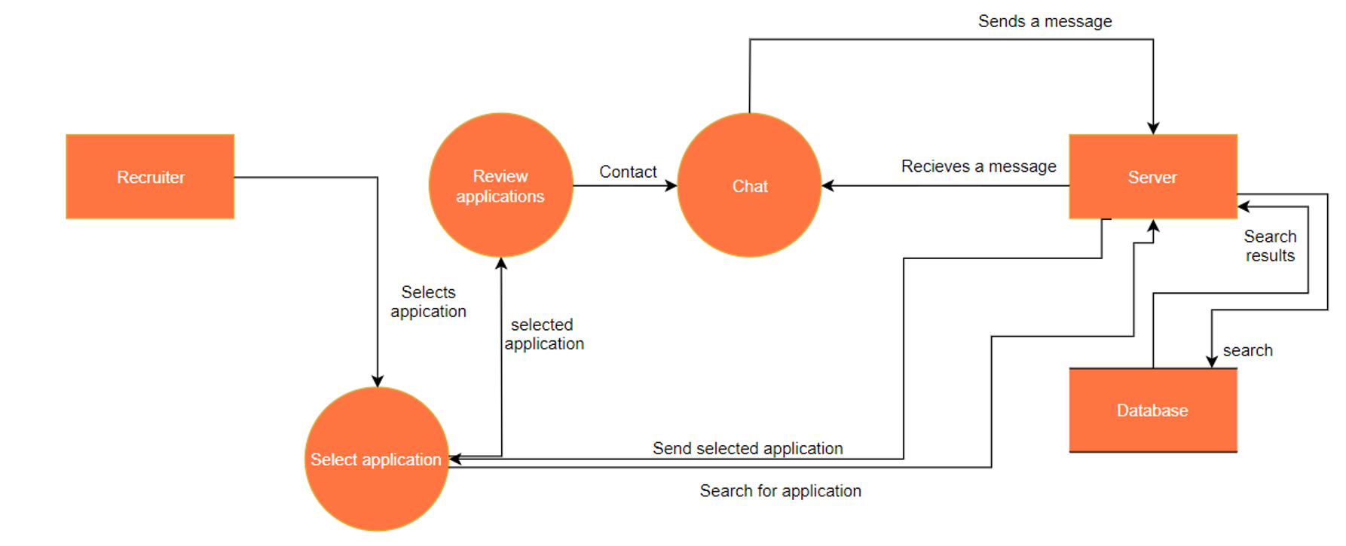
Level 2.11 - Review applications by recruiter

Slide 34
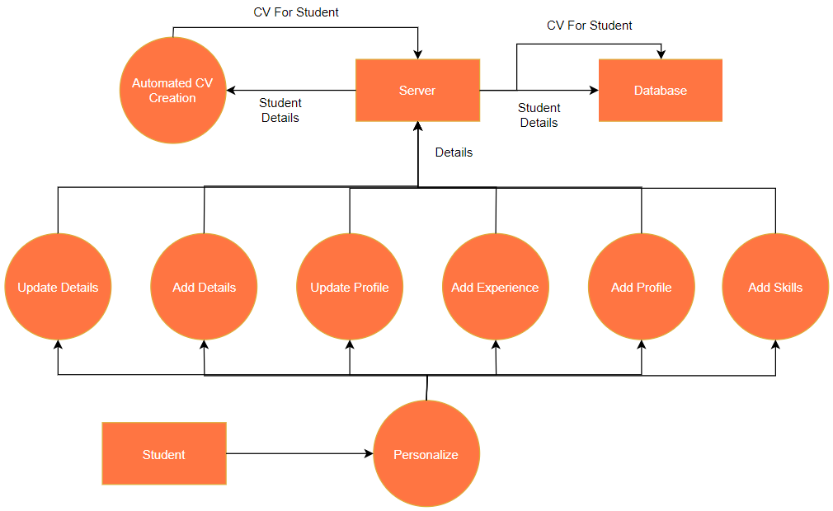
Level 2.12 - Entering personalization details by student

Slide 35
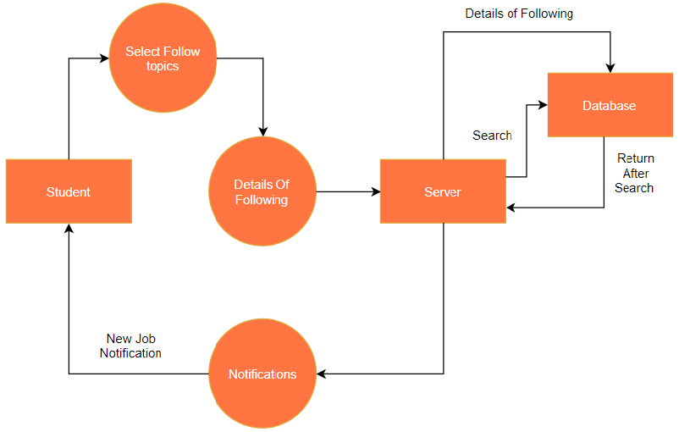
Level 2.13 - Following topics or recruiters by student

Slide 36
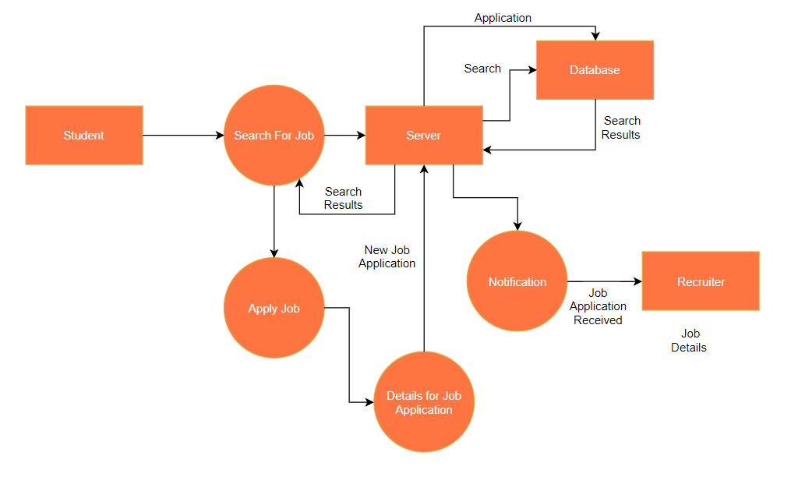
Level 2.14 - Apply for job by student

Slide 37
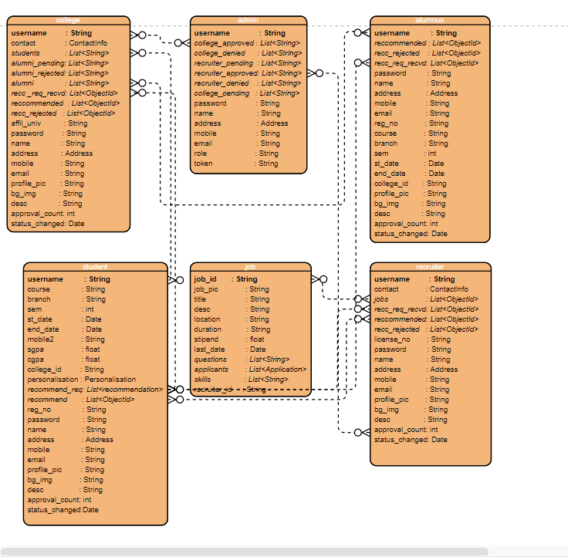

CAREER INFORMATION AND RECRUITMENT PORTAL
DATA
MODELLING
DEPARTMENT OF INFORMATION AND TECHNOLOGY

Slide 38
IMPLEMENTATION
Here we try to provide an overview of the application development involved using sample codes and application screenshots.
DATABASE CONNECTION
VIEW RESOLUTION
EMAIL
spring.data.mongodb.host=localhost
spring.data.mongodb.port=27017
spring.data.mongodb.database=cirp
public void addViewControllers(
ViewControllerRegistry registry) {
registry.addViewController("/home")
.setViewName("index"); registry.addViewController("/")
.setViewName("index"); registry.addViewController("/index")
.setViewName("index"); registry.addViewController("/register").setViewName("register");
registry.addViewController(
"/register-college")
.setViewName("register_college");
/* etc. additional code omitted */
}
@Autowired
JavaMailSender send_email;
public void sendEmail(String to, String sub, String content) {
try {
MimeMessage msg = send_email
.createMimeMessage();
msg.setRecipient( Message.RecipientType.TO,
new InternetAddress(to));
msg.setSubject(sub);
msg.setContent(content, "text/html");
send_email.send(msg);
}
catch (MessagingException e) {
e.printStackTrace();
}
}
SESSION CONTROL
server.servlet.session.timeout = 20m
server.servlet.session.cookie.http-only = true
server.servlet.session.cookie.secure = true
server.error.whitelabel.enabled = false

Slide 39
SECURITY
SERVICE
REPOSITORY
protected void configure(HttpSecurity http) throws Exception {
http.authorizeRequests().antMatchers("/", "/index", "/home", "/register", "/register-recruiter", /register-college", "/register-alumnus", "/terms-and-conditions", "/error", "/login").permitAll()
.antMatchers("/admin-panel").hasRole("ADMIN")
.antMatchers("/college-home", "/college-admin-panel").hasRole("COLLEGE")
.antMatchers("/recruiter-home", "/create-job", "manage-job", "job-applications").hasRole("RECRUITER")
.antMatchers("/student-home").hasRole("STUDENT")
.antMatchers("/alumnus-home").hasRole("ALUMNUS")
.anyRequest().authenticated()
.and()
.formLogin().successHandler(customizeAuthenticationSuccessHandler).loginPage("/login")
.failureUrl("/login?error=true").and()
.httpBasic();
}
// Sample code from services package
public void resetPassword(String username, String new_password) {
Class<?> user_class = find.findClass(username);
repo.updatePassword(username, passwordEncoder.encode(new_password), user_class);
repo.setToken("", username, user_class);
}
@Scheduled(cron = "0 0 12 * * ?") // Scheduled to run at 12 PM everyday
public void deleteRejectedRegistrations() {
Calendar calender = Calendar.getInstance();
calender.setTime(new Date());
calender.add(Calendar.DATE, -14);
cirpRepository.deleteRejectedRegistrations(calender.getTime());
}
// Sample code from repository
public void updateContact(ContactInfo contact, String username, Class<?> user_class) {
Query query = new Query();
query.addCriteria(where("username")
.is(username));
mongoTemplate.updateFirst(query, new Update().set("contact", contact), user_class);
}
CONTROLLER
//Sample code from controllers package
@PostMapping(value="/accept-user")
public String acceptRegistration(@RequestParam String username, Authentication authentication, RedirectAttributes redirectAttributes) {
accept_reject.acceptRejectRegistration(username, "confirm", authentication.getName());
return "redirect:/admin/admin-panel"; }

Slide 40
APPLICATION SCREENSHOTS

Slide 41
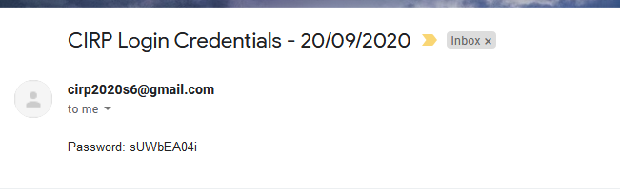
Application startup: all admins are created and initialized, they receive the randomly generated password by email.

Slide 42
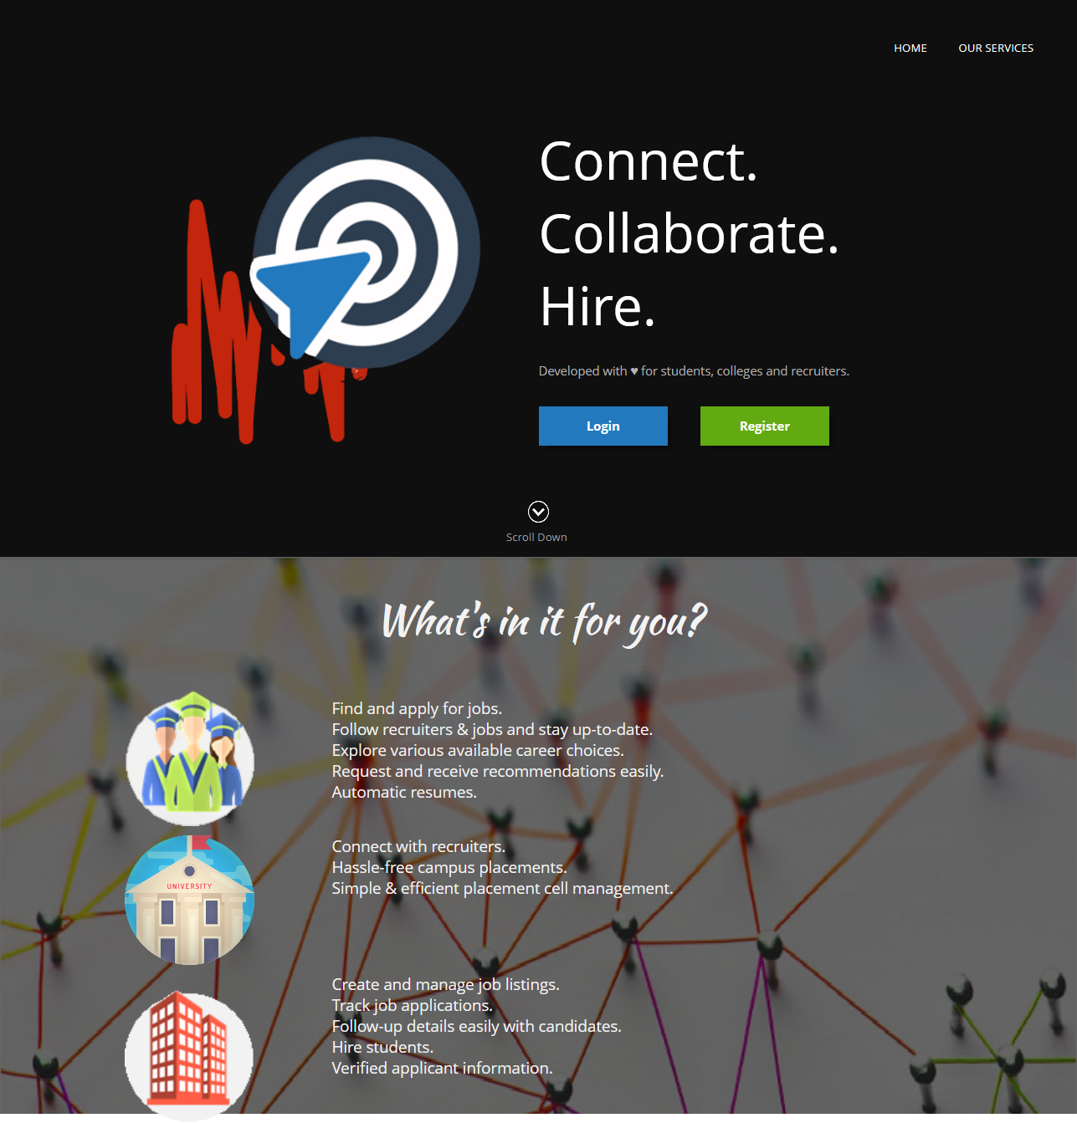
Full page screenshot of home page. Our Solutions in the navigation bar redirects to the anchor “What’s in it for you?”

Slide 43
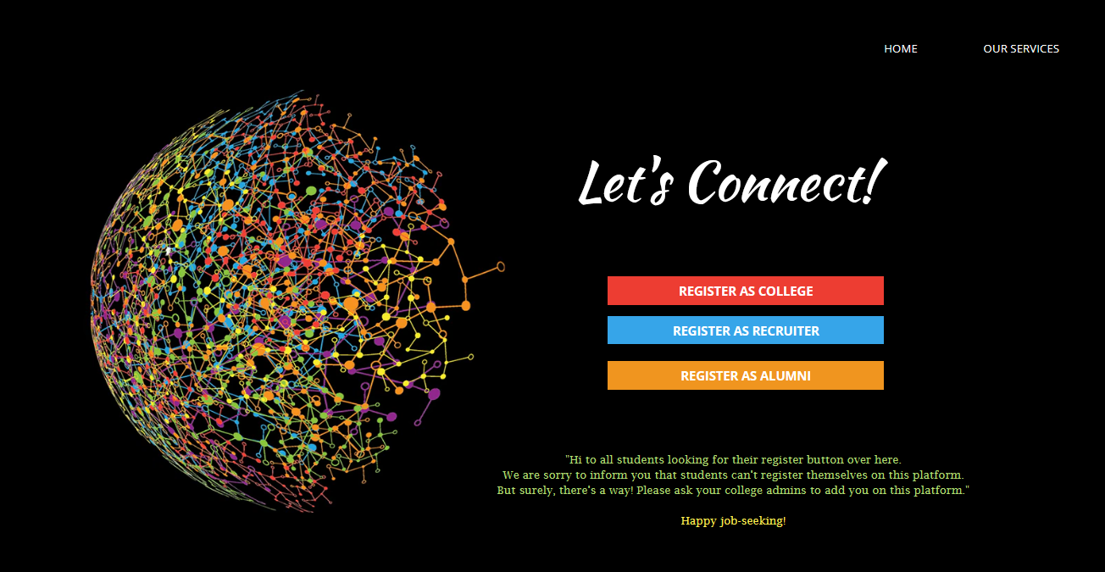
Register Page

Slide 44
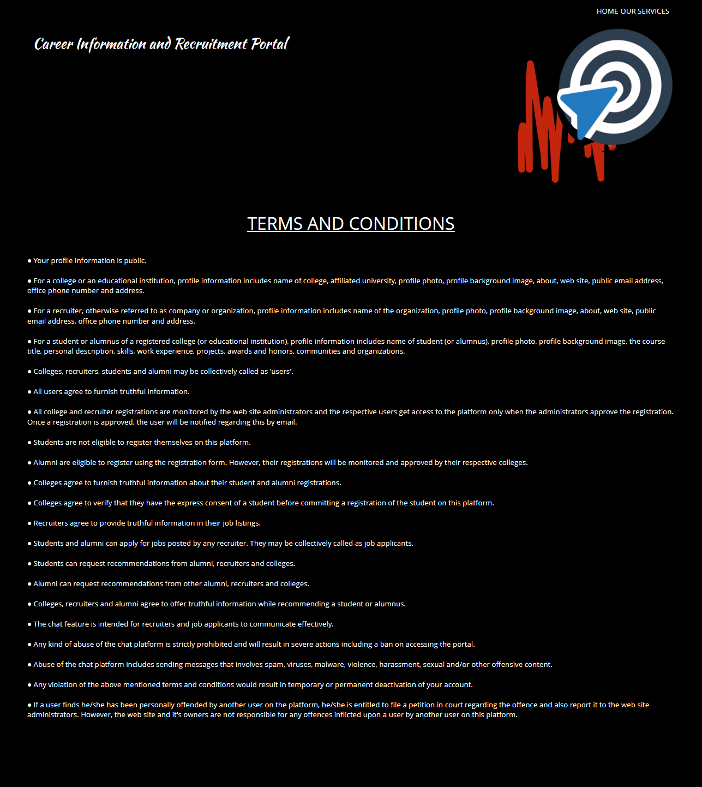
Terms and Conditions Page

Slide 45
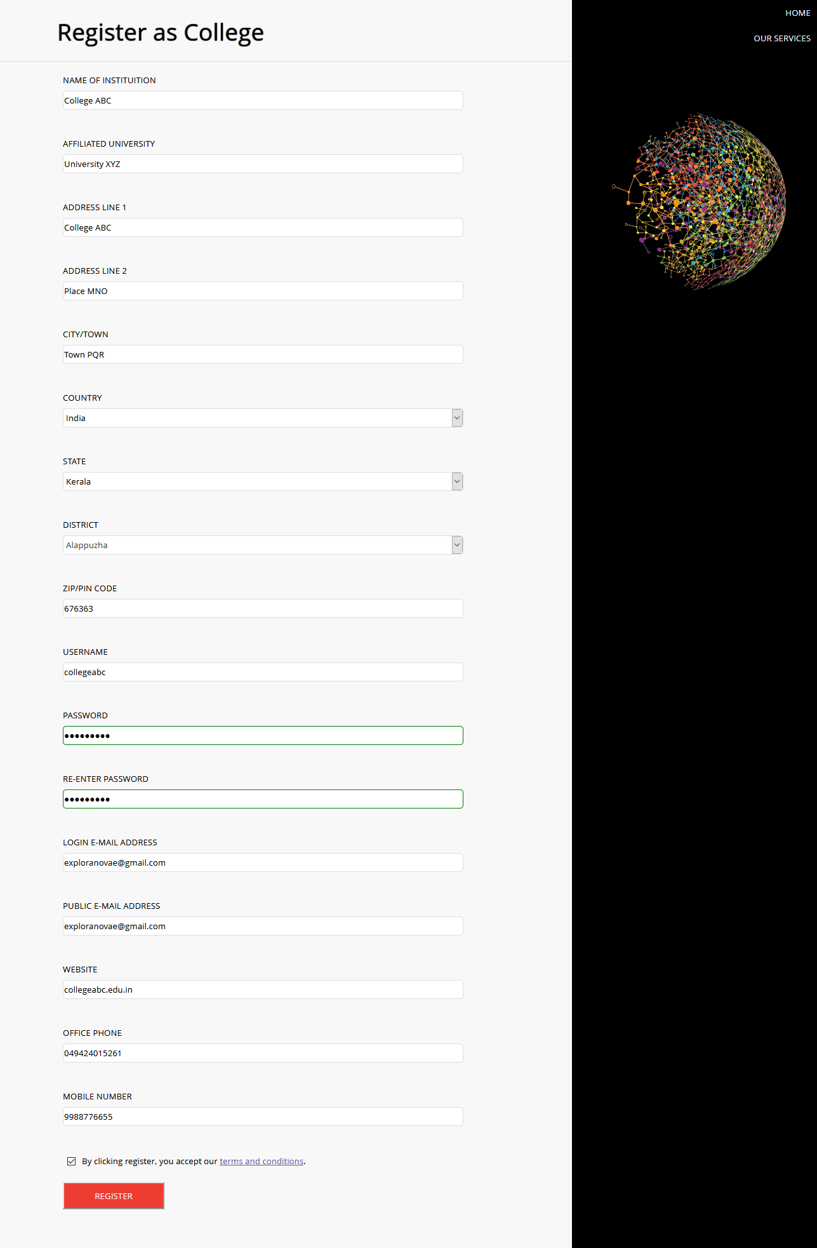
College Registration Page

Slide 46
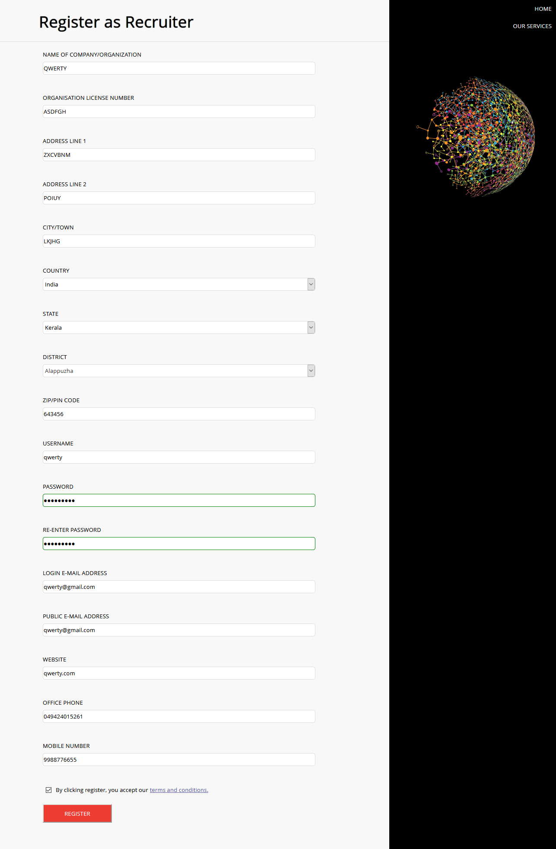
Recruiter Registration Page

Slide 48
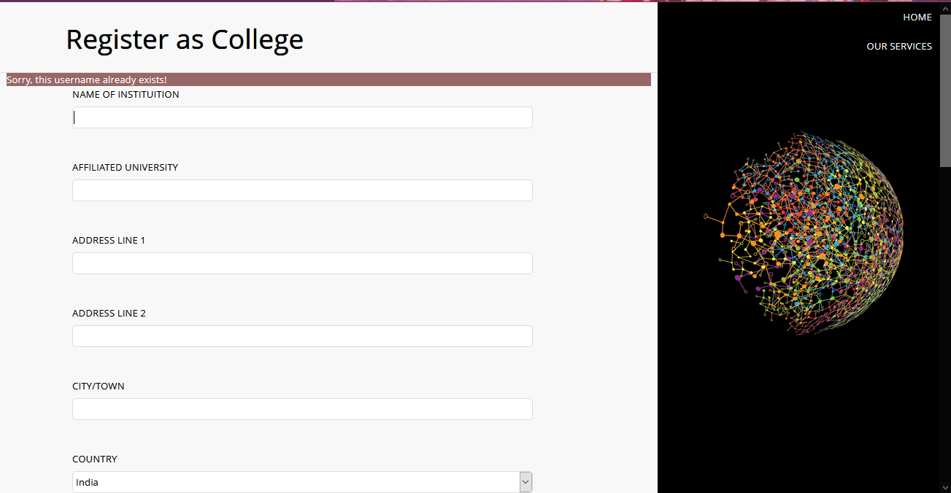
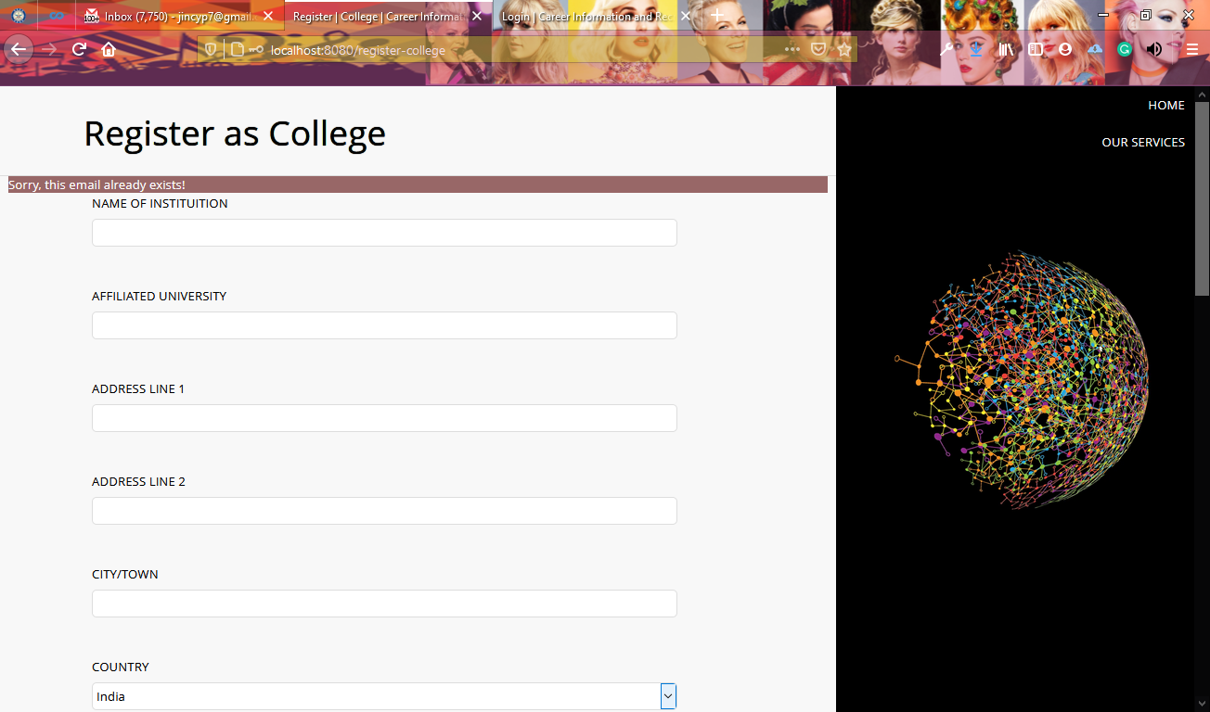
Registration exceptions/success notifications to user.
NB: This is similar in all registration pages and hence avoiding repetition.

Slide 49
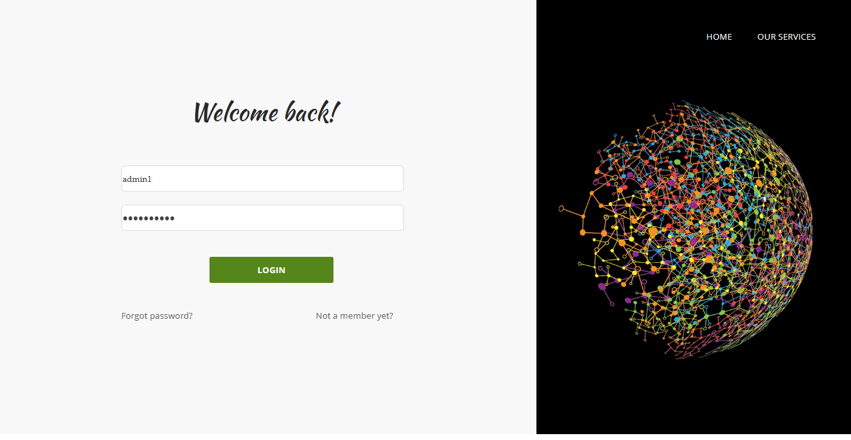
Login with username

Slide 50
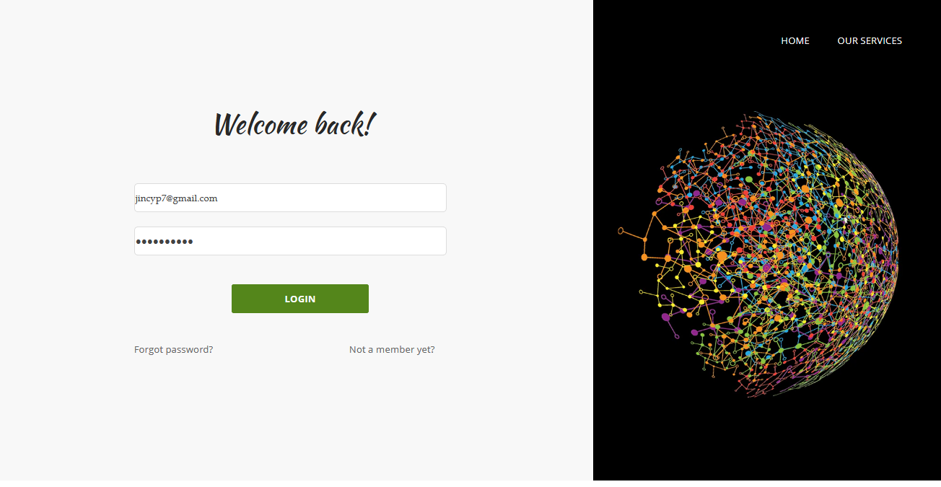
Login with email

Slide 51
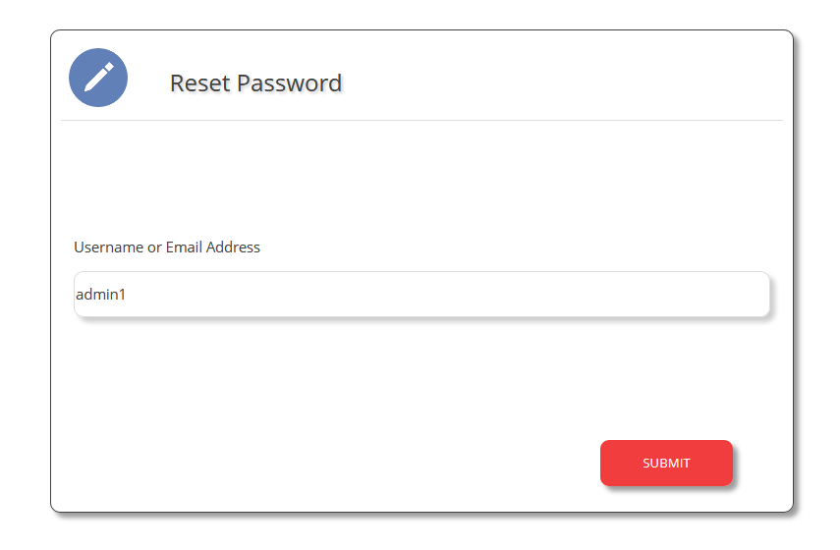
Forgot password from login page redirects here

Slide 52
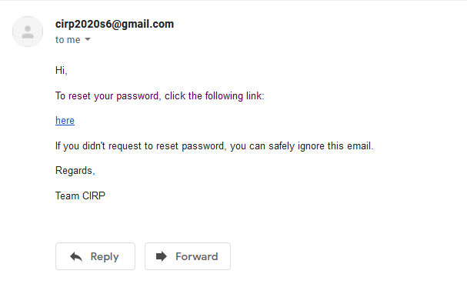
Reset password link send to user’s email.

Slide 53
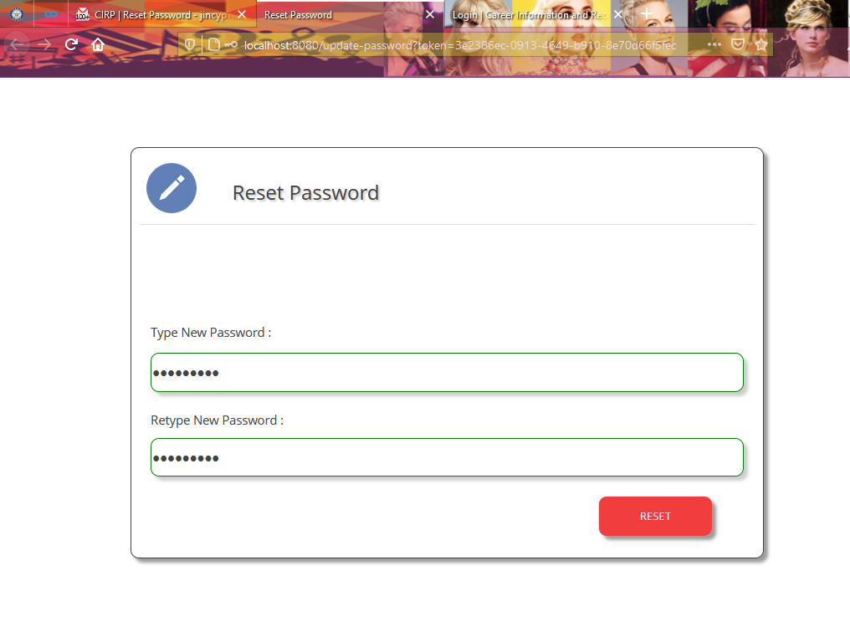
Form to reset password.
NB: Browser navigation bar is included in the screenshot to assert token based and user-specific password reset link.

Slide 54
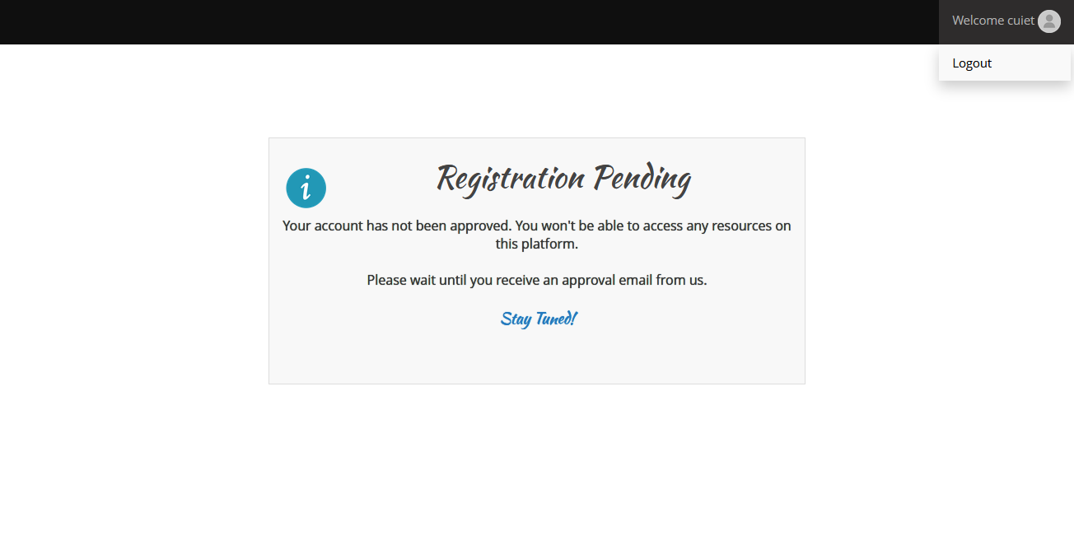
Logins of users whose registrations are not yet approved redirects to this Registration Pending page. As you can see from the above screenshot, such users cannot access any other pages.

Slide 55
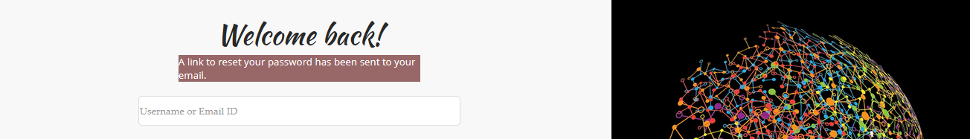

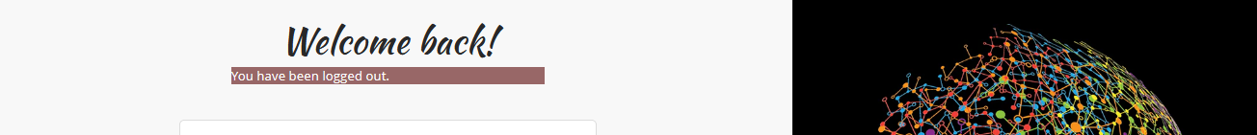
Notifications on login page regarding password reset and log out.

Slide 56
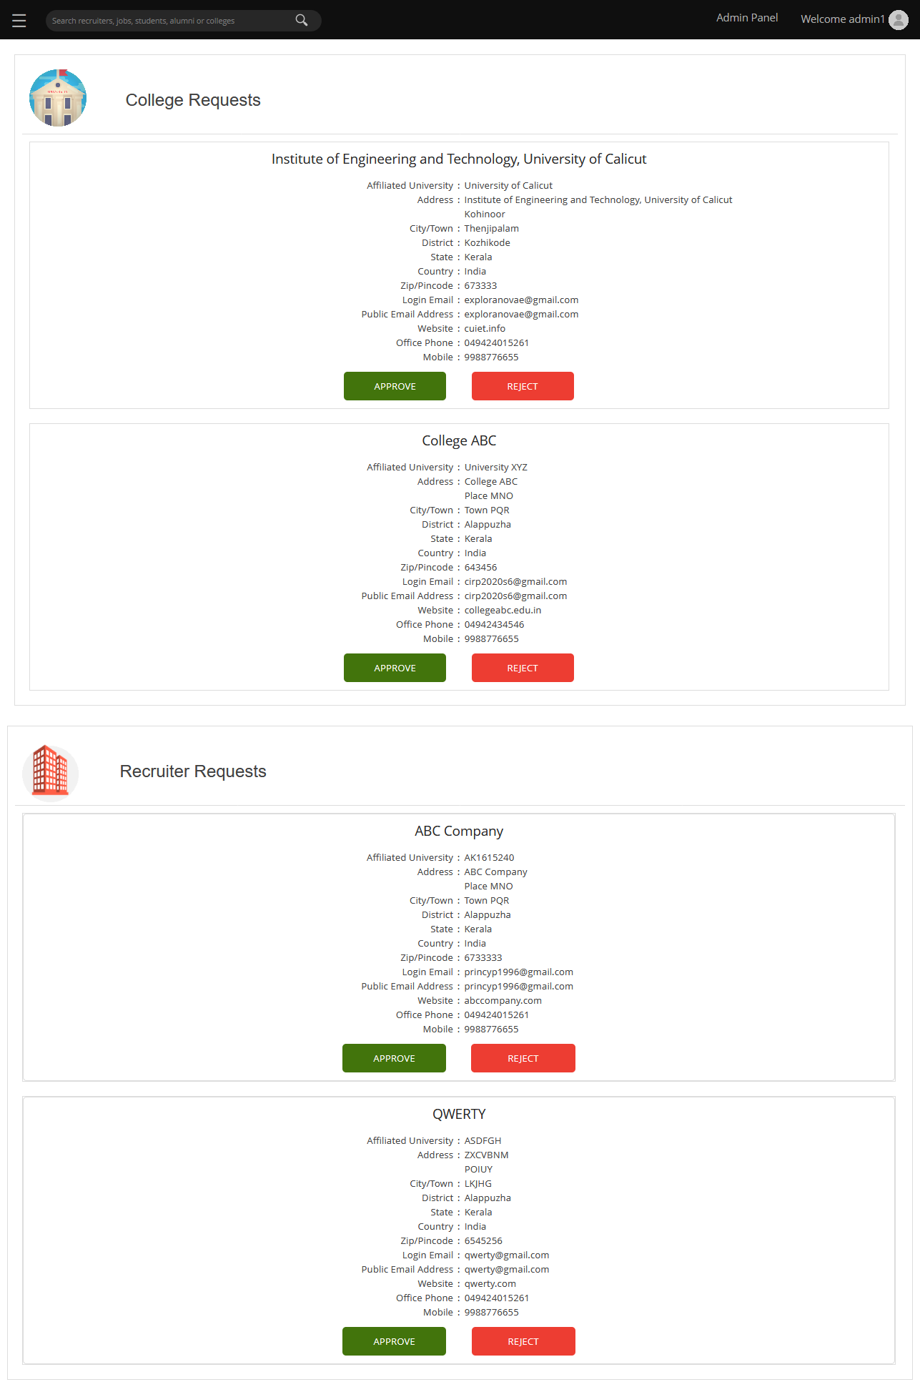
Admin Panel for website administrators with 2 pending college and recruiter registration requests each.
(The screenshot has been cropped and placed side-by-side for better legibility.)

Slide 57
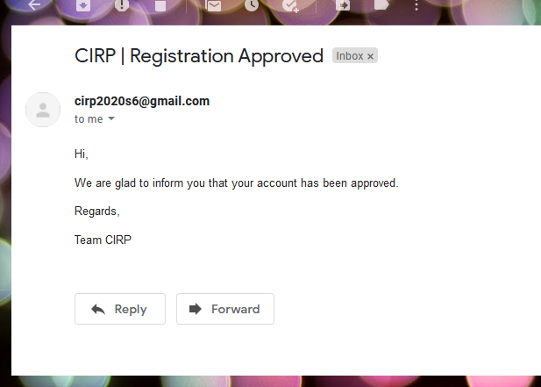
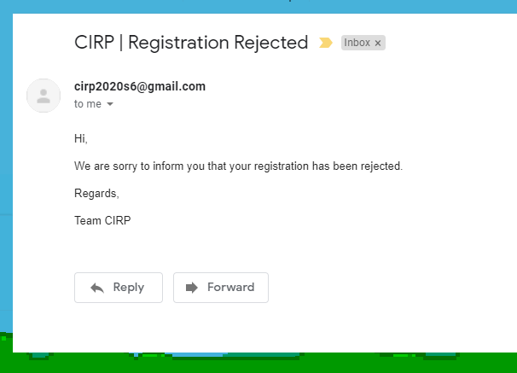
Users receive approved or rejected registration email when all admins (associated college, in case of alumnus) approve their request.

Slide 58
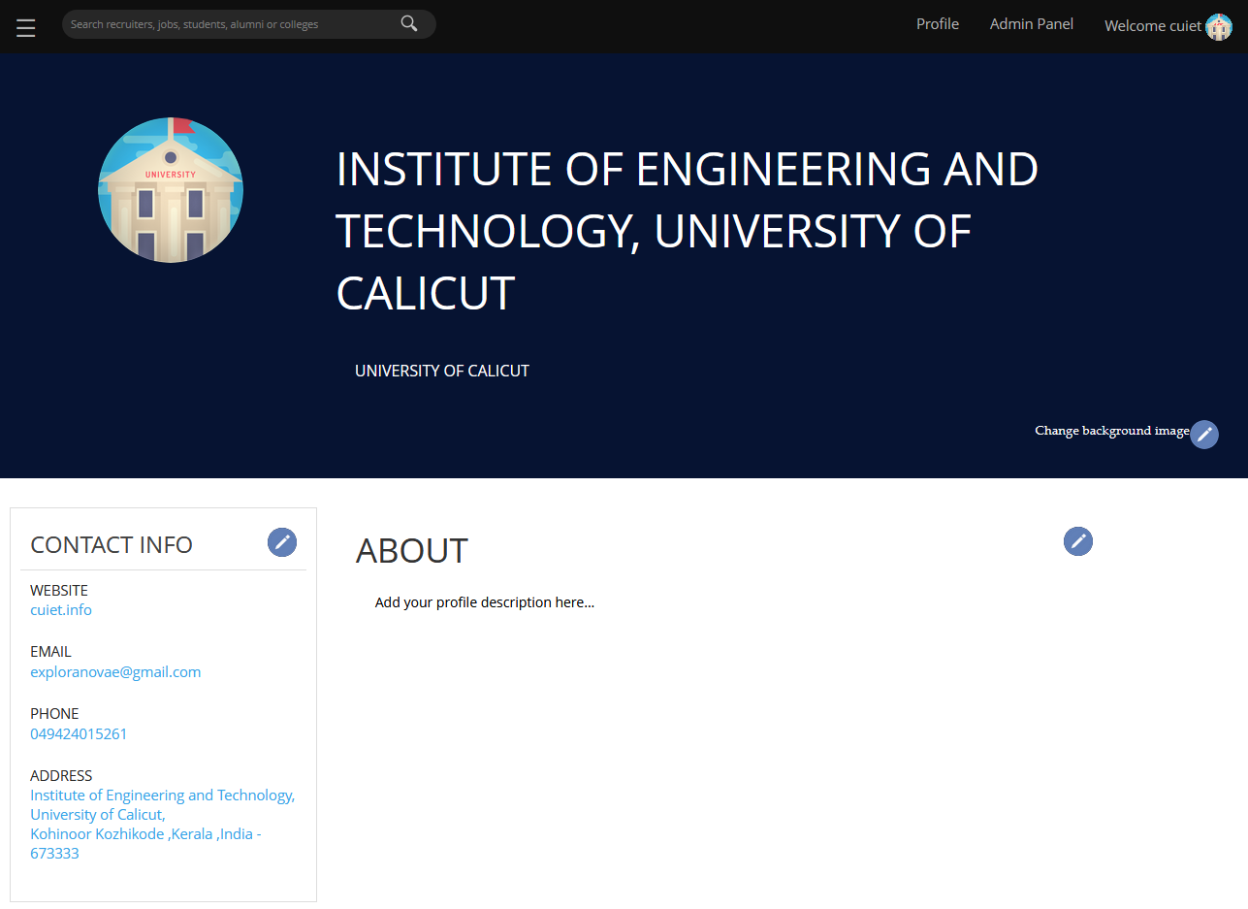
Home page (profile) for college – default – before user adds any customization.

Slide 59
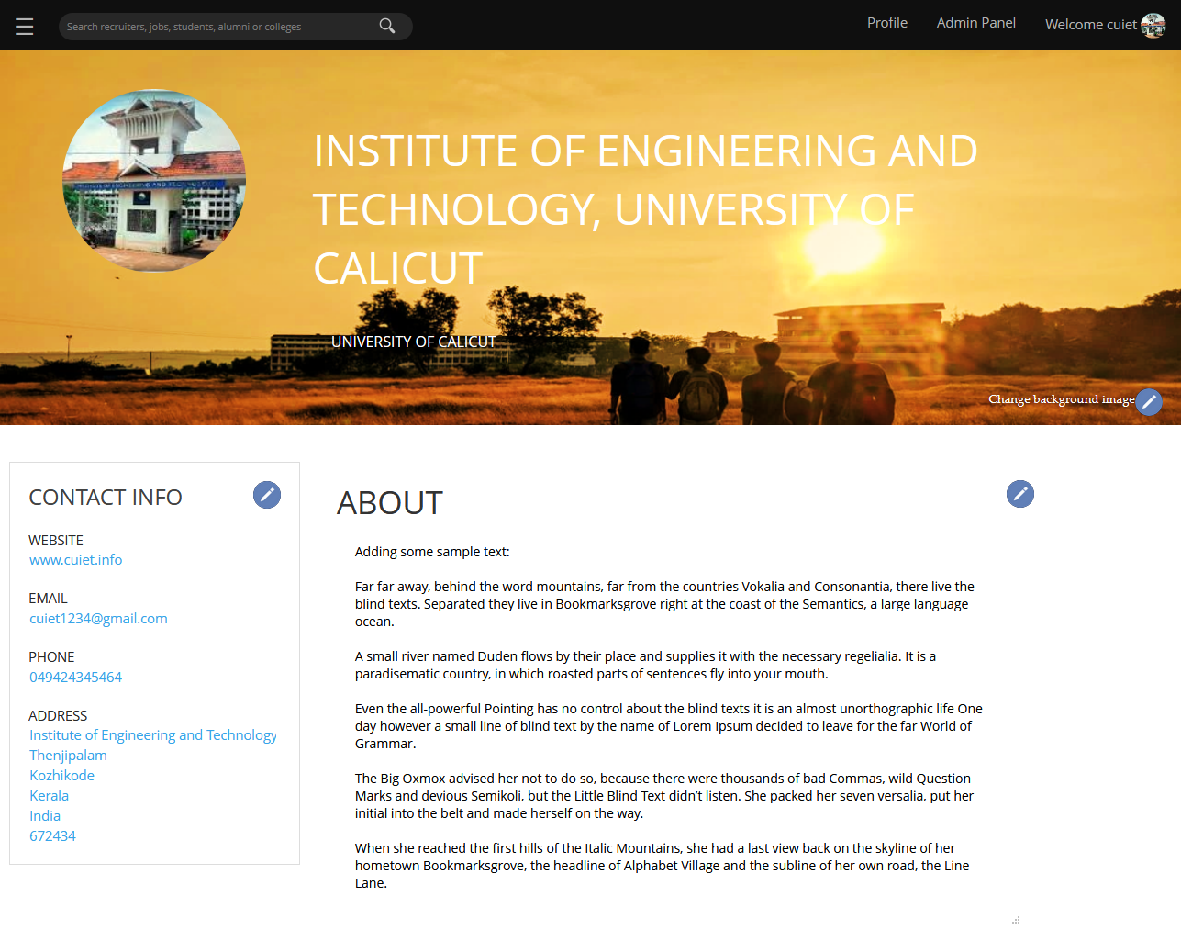
Home page (profile) for college – after the user has added all possible customizations.

Slide 60
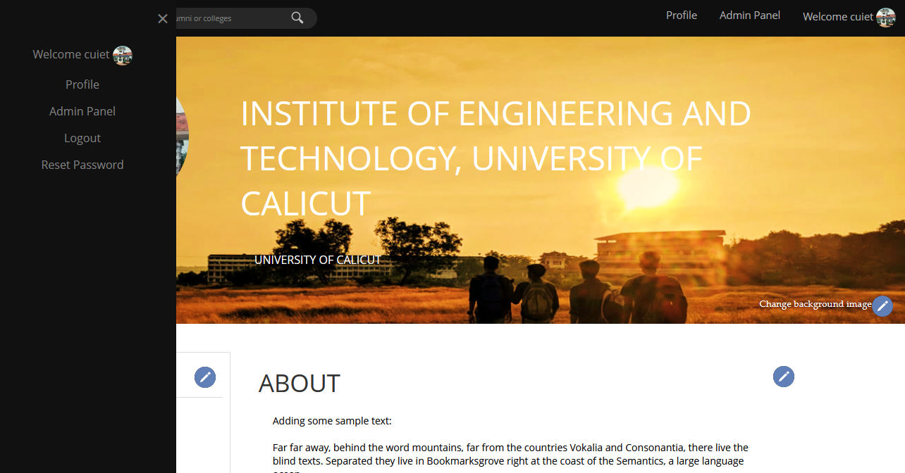
Side menu bar

Slide 62
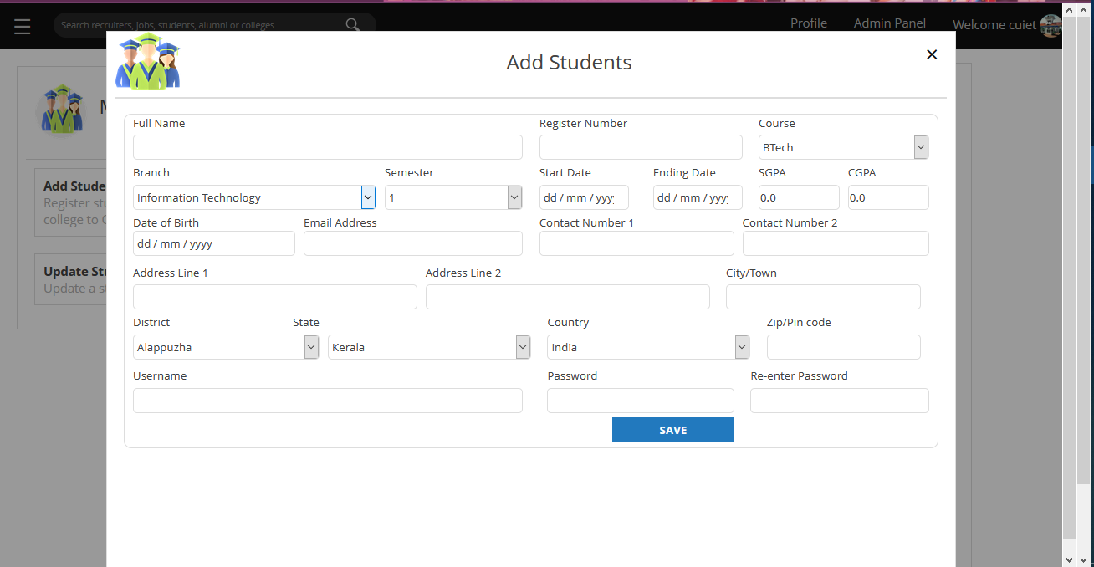
Add Students – College Admin Panel

Slide 63

Home page (profile) for recruiter – after the user has added all possible customizations.

Slide 70

Error or Exception Handling

Slide 71
TESTING
UNIT TESTING
INTEGRATION TESTING
VALIDATION TESTS
JUnit tests where conducted for each of the modules and packages in the application.
Tests were repeated with various use cases and asserted that all functionalities were working as expected.
After all unit tests where successful, the packages where tested for integration and compatibility.
When necessary, individual packages and modules were reconfigured to adapt for better integration.
Validation tests were achieved with the combined application of data model constraints, controller annotations and UI restrictions.

Slide 72
SAMPLE TEST CASES
UNIT TESTING
INTEGRATION TESTING
Create Job
{
"_id":"5f677262f5dad49355aa7bb0",
“recruiter_id":“recruiter1",
“title”:”Software Developer”,
“desc”:”Sample test case – software developer job”,
“location”:”Place ABC”,
“duration”:”3 months”,
“stipend”: 35000,
“last_date": {
“$date": "2020-09-28T18:30:00.000Z“
}
}
Register College, Update Profile Info
{
"_id":"cuiet",
"affil_univ":"University of Calicut",
"contact": {
"website":"cuiet.info",
"landph":"049424015261",
"public_email":"exploranovae@gmail.com",
"address_line1":"Institute of Engineering and Technology, University of Calicut",
"address_line2":"",
"city_or_town":"Thenjipalam",
"district":"Kozhikode",
"state":"Kerala",
"country":"India",
"pincode": {
"$numberLong":"673333“
}
},
"approval_count":4,
"password":"$2a$10$C./AIEdRrnk03UJAKJ3U8ufm6LzNHeDrz8z4yD8zjLsNgZMf.ypxK",
"name":"Institute of Engineering and Technology, University of Calicut",
"mobile":"9988776655",
"email":"exploranovae@gmail.com",
"status":1,"role":"ROLE_COLLEGE","_class":"com.cirp.app.model.College",
"desc":"Institute of Engineering and Technology is a Self-Financing Engineering College run by the University of Calicut. The institute was established in the year 2001 with the aim to promote education and research in the field of engineering and technology and to groom the young men and women into high-quality technical personnel useful to the society”
}
VALIDATION TESTS
Sample screenshots for validation tests are included in the following slides

Slide 73

Homepage displayed to a user when the account is pending approval from administrators

Slide 74

Input validation in UI, the form cannot be submitted without filling all required fields.
Red border is used to indicate invalid input. Green border for password inputs indicate passwords are matching.

Slide 75
FUTURE PERSPECTIVES
Finding a job opportunity as per your choice and qualifications becomes much easier through career information and recruitment portal.
Recruiters will be able to find candidates with good skills based on their own recruitment criteria.
The application can potentially replace manually maintained system for campus recruitments.
Future development scopes for the application include job/candidate suggestions using AI, advanced application tracking, etc.

Slide 76
CONCLUSION
This project provided us practical knowledge about Java enterprise web application development using spring boot and spring security frameworks, and MongoDB platform.
The application offers simple and interactive forms, which helps users to access data through a secure gateway.
The developed system is efficient and commercially deployable.
Job aspirants, recruiters and colleges can take advantage of this web application as an excellent job board.

Slide 77
REFERENCES
[1] Rajib Mall, Fundamentals of Software Engineering, 2nd ed., IN: PHI, 2003
[2] Pankaj Jalote, A Concise Introduction to Software Engineering, 1st ed., UK: Springer, 2008. [E-book] Available: Springer e-book
[3] Barber L. (Mar 2006). e-Recruitment Developments. Institute for Employment Studies, Brighton. [Online] Available: https://www.employment-studies.co.uk/resource/erecruitment-developments
[4] Ranga Karanam, Creating a Web Application with Spring Boot, DZone, Jun. 02, 2017. Accessed on: Jul. 08, 2020. [Online] Available: https://dzone.com/articles/creating-a-web-application-with-spring-boot

Slide 78
THANK YOU!

